Slide 1
Correlating the personality and diseases using genomes
Under the Guidance of
Dr. P. Jayashree
Team Members
Gowtham V
Swetha B
Girinathaprasad B

Slide 2
Problem statement
Personality traits are the relatively enduring patterns of thoughts, feelings and behaviors that reflect the tendency to respond in certain ways under certain circumstances. Twin and family studies have showed that personality traits are moderately heritable, and can predict various lifetime outcomes, including psychopathology.
Predict the Personality Trait of the person based on his genome analysis to forecast the disease that could occur to the individual.

Slide 3
Introduction
Personality Traits were measured with the NEO Personality Inventory, which was designed to characterize the five factor model of the ‘Big Five Dimensions’ of Personality.
With the development of behavioral genetics, personality was established a inheritable trait.
On average female adults were more neurotic and agreeable than male adults. The results tended to support previous research in that a negative relationship was found between neuroticism and cancer, and a positive relationship was found between neuroticism, stress-related symptoms, and cardiovascular symptoms

Slide 4
Modules
Gene Prediction
SNP Prediction
Classifier for Personality trait
Correlating b/w diseases and personality
Classifier for Diseases

Slide 5
Literature Survey
S NO | Title | Authors | Methodology | Merits
1 | Pathway analysis of genome-wide association datasets of personality traits | H.-N. Kim, B.-H. Kim, J. Cho, S. Ryu, H. Shin, J. Sung, C. Shin, N. H. Cho, Y. A. Sung, B.-O. Choi and H.-L. Kim. | Analyzing correlation between genome and traits based on 1042 pathways | Analyzing of interactions of gene set with the personality traits

Slide 6
Literature Survey
S NO | Title | Authors | Methodology | Merits
2 | Genome-wide association study of the five-factor model of personality in young Korean women | Han-Na Kim, Seung-Ju Roh, Yeon Ah Sung, Hye Won Chung, Jong-Young Lee, Juhee Cho Hocheol Shin and Hyung-Lae Kim | Performed a GWA study of 2,053,685 SNPs from 1089 women and analysed the SNPs that relate to the personality trait. | Showed the key genes associated with the personality traits.

Slide 7
Literature Survey
S NO | Title | Authors | Methodology | Merits
3 | Genome-wide association scan for five major dimensions of personality | A Terracciano, S Sanna, M Uda, B Deiana, G Usala, F Busonero, A Maschio, M Scally, N Patriciu1, W-M Chen3 | 1)Recruited subjects 2)Personality assessment 3)Genotyping and imputation 4)GWA analysis on the data with traits | Provide the P values and Z values associated with each trait

Slide 8
Proposed Solution
Convert the gene sequence and SNP sequence into image using opencv of 300 x 300 pixels (i.e., 90,000 pixels)
Extract the features from the image using the convolutional neural network
Predict the Gene type and SNP associated with the sequence with the help of the model which is generated from the convolutional neural network
Generate the fuzzy inference model for the analyzed gene type and SNP that are related to personality trait and diseases and predict the personality associated and disease related to it.

Slide 9
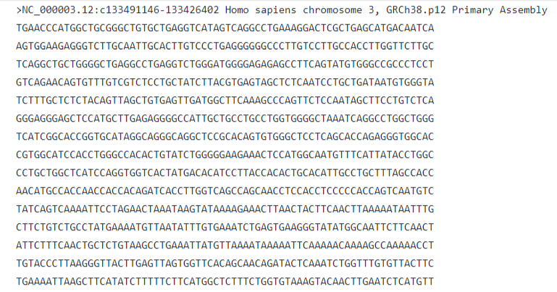

Accomplished Works
Sequence to image Conversion

Slide 10
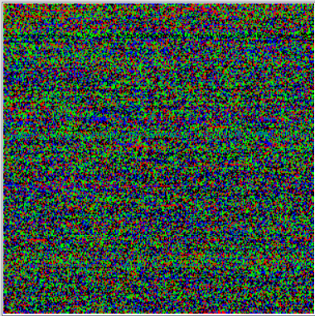
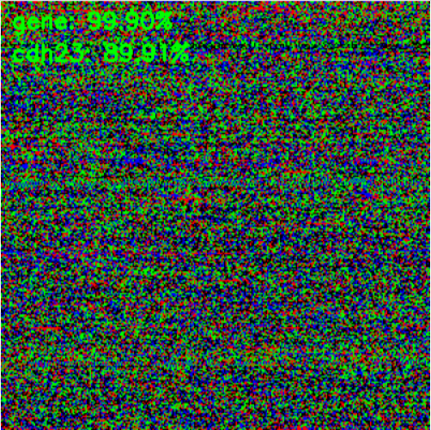
Accomplished Works
Gene Prediction

Slide 11
Accomplished Works
Model Architecture
32
3X3
Conv
64
3X3
Conv
64
3X3
Conv
128
3X3
Conv
128
3X3
Conv
1024
bfsp2
cdh13
………
mist

Slide 12
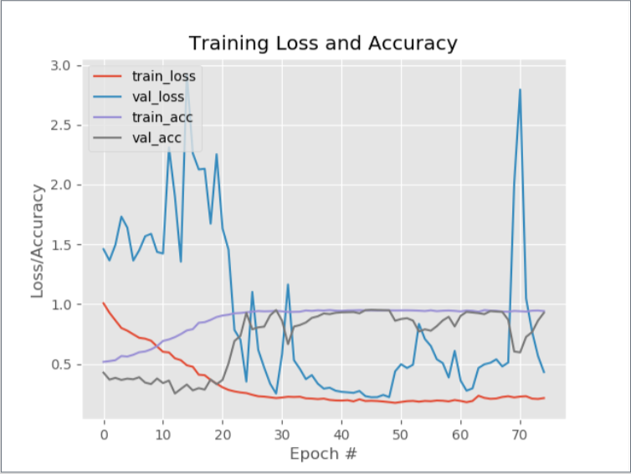
Key Parametric Index
Model Size : 11,000 KB
Model Accuracy : 92.86
Inference Time : ~ 2.3 Secs

Slide 13
Objectives
DNN Model Generation with less No of trainable parameters
Optimizing the model for higher prediction
Minimum Model Size that could be achieved for deployment on Device
Minimum Inference Time

Slide 14
References
A Terracciano, S Sanna , M Uda, B Deiana, G Usala, F Busonero, A Maschio, M Scally. Genome-Wide Association Scan For Five Major Dimensions Of Personality.2013
Han-Na Kim1, Seung-Ju Roh1, Yeon Ah Sung2, Hye Won Chung3, Jong-Young Lee4, Juhee Cho5. Genome-Wide Association Study Of The Five-Factor Model Of Personality In Young Korean Women.2010
H.-N. Kim, B.-H. Kim, J. Cho, S. Ryu. Pathway Analysis Of Genome-Wide Association Datasets Of Personality traits.2015.
S. Sanchez-Roige, J. C. Gray, J. MacKillop, C.-H. Chen, A. A. Palme. The genetics of human personality.2017.
A. Narayanana, E.C. Keedwella, J. Gamalielssonb, S. Tatinenia. Single-layer artificial neural networks for gene expression analysis.2003.

Slide 15
Thank You

